Slide 1
Programming for Analytics
DNSC 4211
Intro to Command Line Interfaces

Slide 2
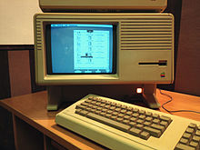
History of User Interfaces
Beginning in 1979, started by Steve Jobs and led by Jef Raskin, the Apple Lisa and Macintosh teams at Apple Computer (which included former members of the Xerox PARC group) continued to develop such ideas.
The Lisa, released in 1983, featured a high-resolution stationery-based (document-centric) graphical interface atop an advanced hard disk based OS that featured such things as preemptive multitasking and graphically oriented inter-process communication.

Slide 3
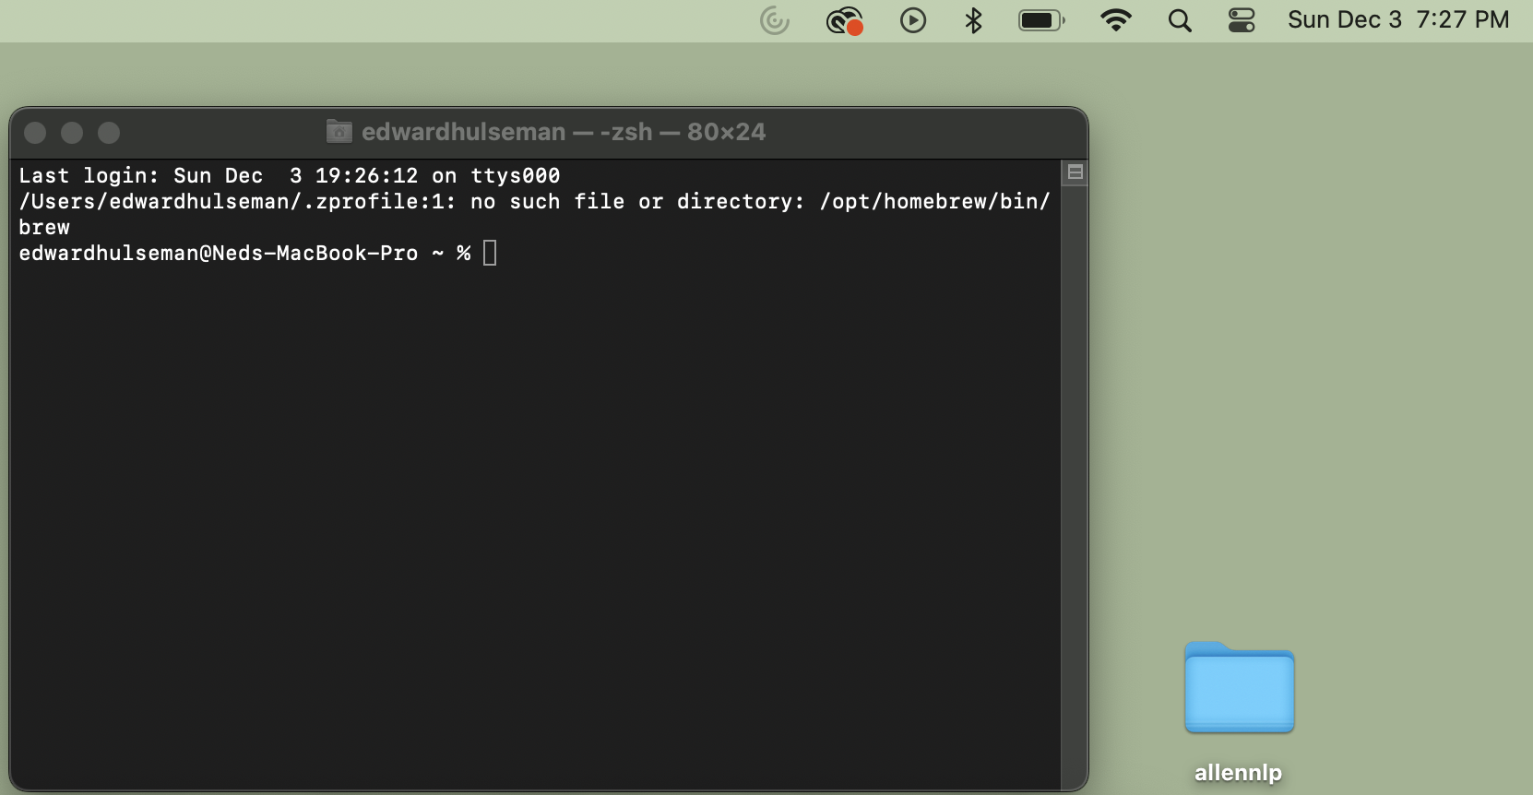
Modern Command Line Interfaces
For Mac Users
Mac users will have command-line access through the terminal program
Mac uses the Unix operating system, that has similar syntax to Linux
To open a terminal window, search for Terminal in the search bar, probably located in the top right corner

Slide 4
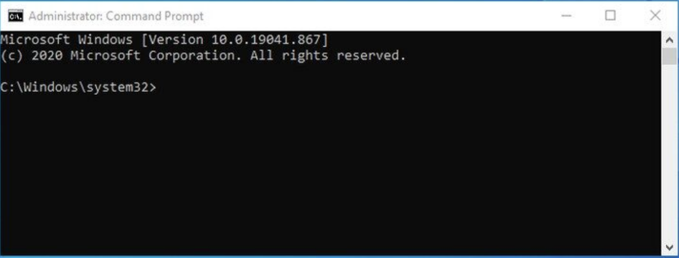
Modern Command Line Interfaces
For Windows Users
Windows users will have command-line access through CMD and PowerShell programs
For today, we will primarily focus on CMD
To open a CMD window, hit the windows key and search for “CMD”

Slide 5
Where Am I?
One of the first things you may be wondering is where exactly are you within your computer’s file system? We will execute our very first command to find out!
Terminal
edwardhulseman@Neds % pwd | Print Working Directory, prints the path where the terminal currently is
CMD
C:\ >>> cd | Print Working Directory, prints the path where the terminal currently is

Slide 6
Let’s Change our Directory
Let’s change our directory to our Desktop so that we can create a new directory there
Terminal
edwardhulseman@Neds % cd Desktop | cd stands for Change Directory, and can be used to traverse the file system
CMD
C:\ >>> cd Desktop | cd stands for Change Directory, and can be used to traverse the file system

Slide 7
Let’s create a new directory
To create a new directory (e.g. folder) we will need to name it something. Let’s make a folder named DNSC_CLI
Terminal
edwardhulseman@Neds % mkdir DNSC_CLI | mkdir or “Make Directory” expects one argument, the name of the new directory
CMD
C:\ >>> mkdir DNSC_CLI | mkdir or “Make Directory” expects one argument, the name of the new directory

Slide 8
CD into the new folder and add a file
Go to the new folder with File Explorer or Finder and add a new file called test.py
From the command line CD into the new folder

Slide 9
Use the CLI to Print Files
Often times, it is helpful to see what is in a directory. Use the following commands to find out.
Terminal
edwardhulseman@Neds % ls | The ls command will list all of the files
CMD
C:\ >>> dir | In CMD, it is a slightly different command

Slide 10
Python from the CLI
You can even run Python in the CLI, or start Anaconda-based IDEs such as Spyder or Jupyter Notebook. How exactly this works will depend on how you have set up your Python or Anaconda environment. You can also pip install using the command line.
Terminal & CMD
edwardhulseman@Neds % Python | Depending

Slide 11
Command (Windows) | Command (Mac OS / Linux) | Description | Example
exit | exit | close the window | exit
cd | cd | change directory | cd test
cd | pwd | show the current directory | cd (Windows) or pwd (Mac OS / Linux)
dir | ls | list directories/files | dir
copy | cp | copy file | copy c:\test\test.txt c:\windows\test.txt
move | mv | move file | move c:\test\test.txt c:\windows\test.txt
mkdir | mkdir | create a new directory | mkdir testdirectory
rmdir (or del) | rm | delete a file | del c:\test\test.txt
rmdir /S | rm -r | delete a directory | rm -r testdirectory
[CMD] /? | man [CMD] | get help for a command | cd /? (Windows) or man cd (Mac OS / Linux)

